Slide 1
AI in banking and finance
Ken Liu
31 May 2022

Slide 2






My Background
Study Computer Science
iBanks Algo trade technologist
Startup on Quant Trading, Big Data and AI
Email: wkliu_x@yahoo.com
LinkedIn: https://www.linkedin.com/in/ken-liu-76b11575/

Slide 3

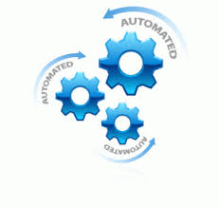
My Industry
Portfolio (what do buy)
Stock Pickings
Fundamental: values, prospects
Quantitative: statistics, models
Trading (how to buy)
Algorithmic Trading
HFT (High Frequency Trading)
Program (Basket) Trading

Slide 4
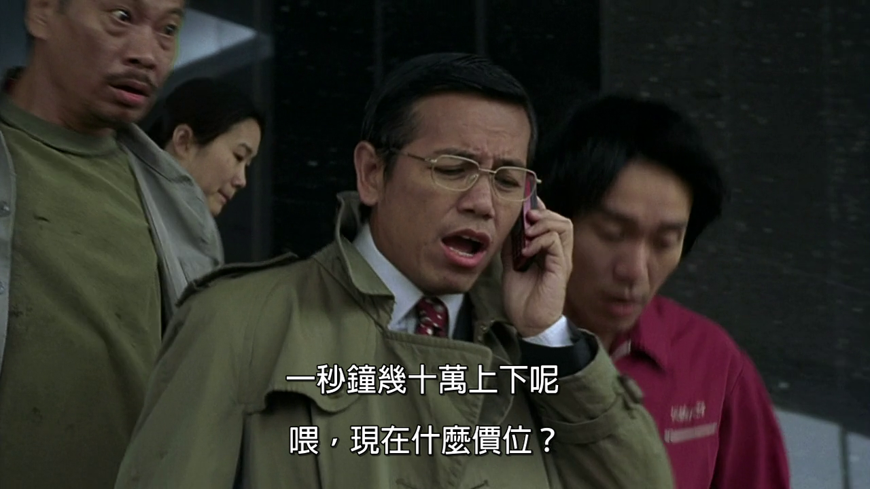
My Work
Sub-header/text/chart/table
“In one second, my portfolio values can go up/down in tens of thousands dollars”

Slide 5
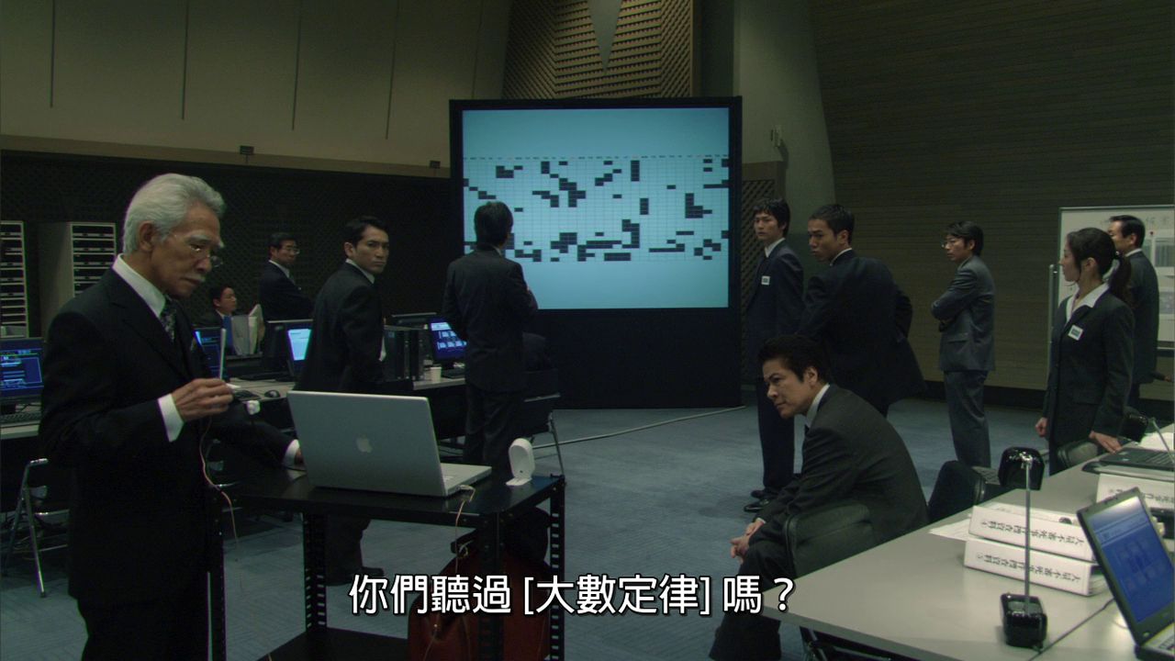
My Work
Sub-header/text/chart/table
“Have you heard of Law of Big Numbers”

Slide 6
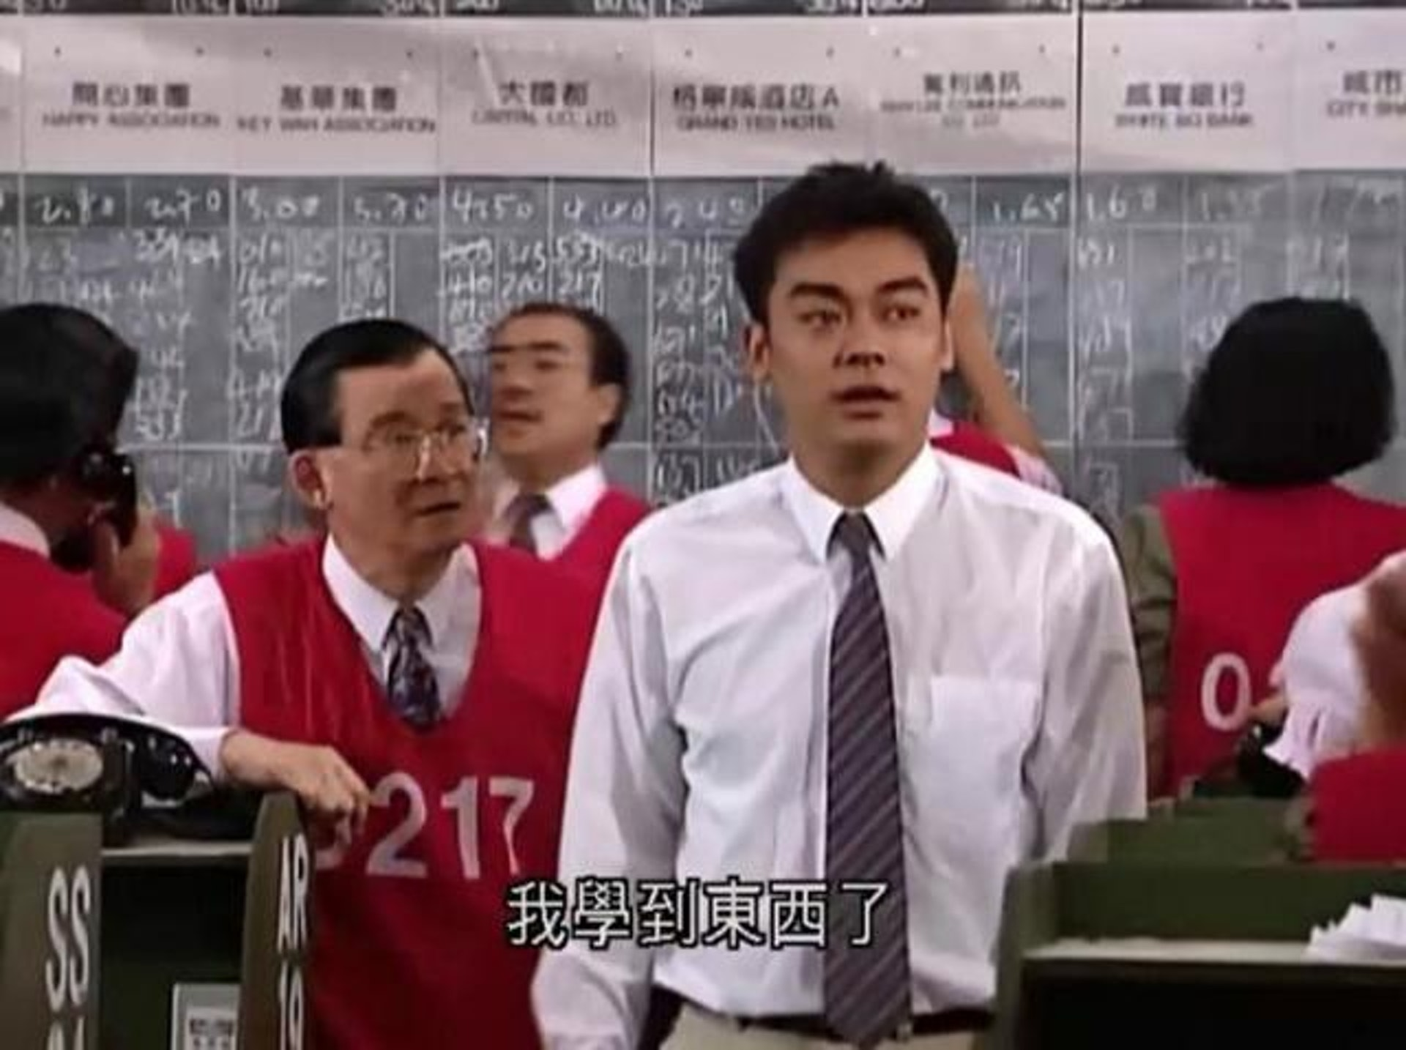
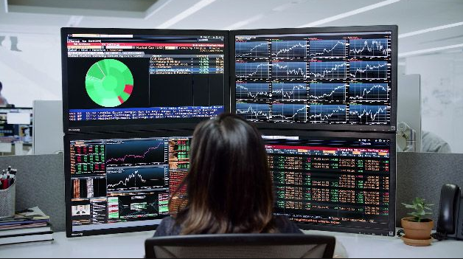
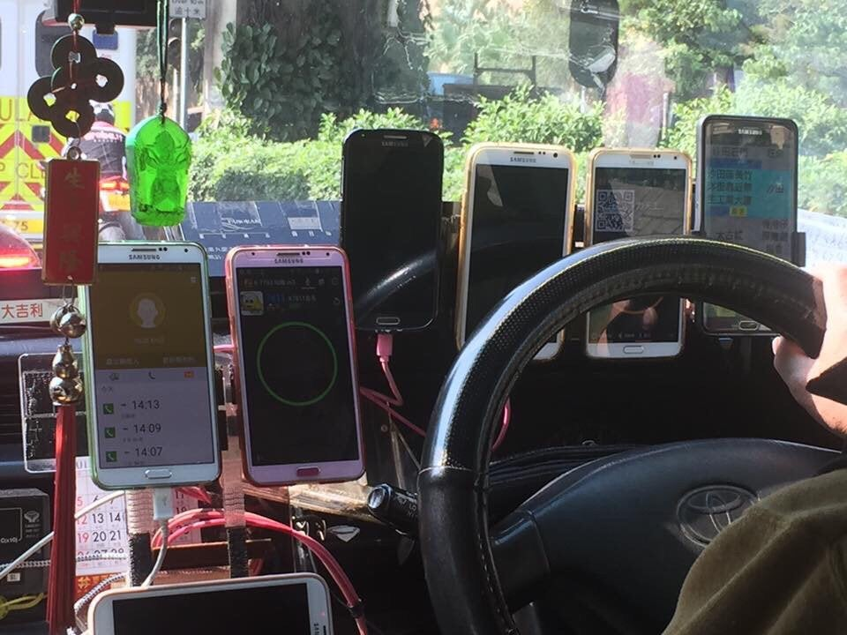
Industrial Practice – Trading Desk
Notes:
Before earn $10 share $5, now earn $10 but share only $1

Slide 7
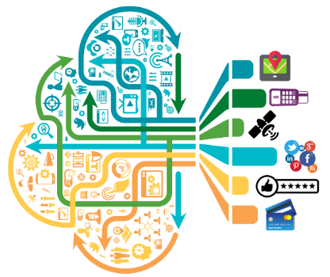
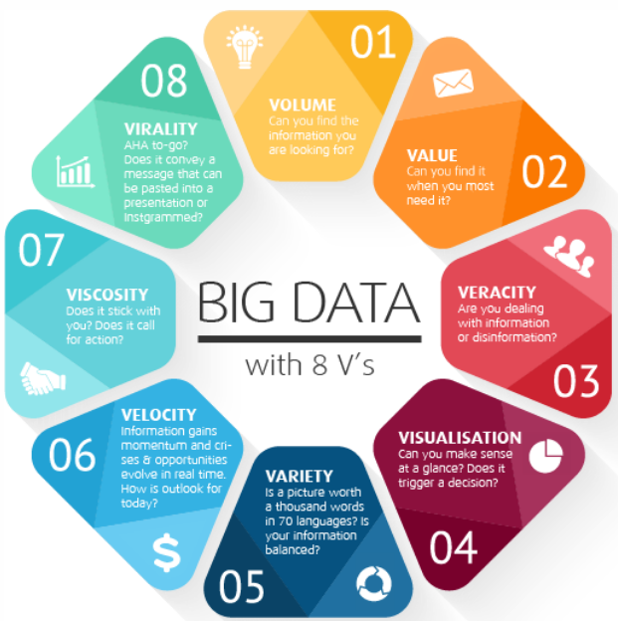
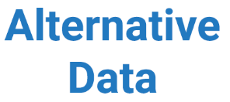
Big & Alternative Data

Slide 8
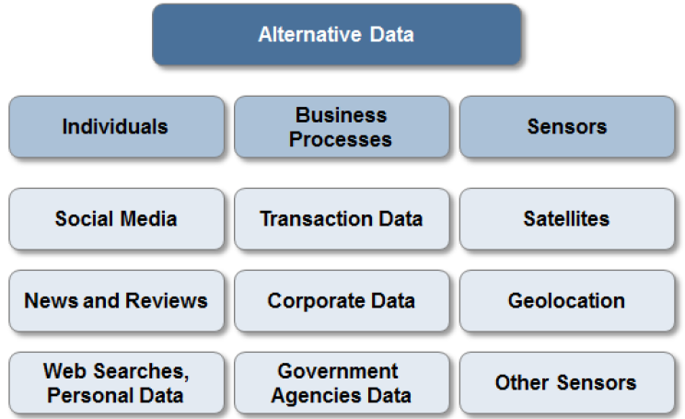
Data, Data, Data….

Slide 9
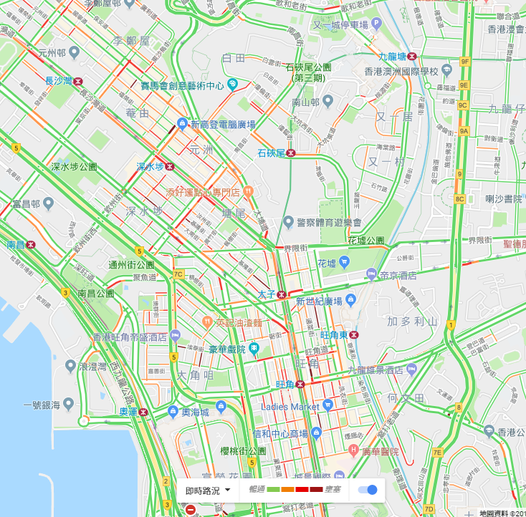
Individuals: Digital Footprints
How Google knows the traffic ?
1. From HK Transport Department ?
2. From Satellite Images ?
3. From You ?
Google Map traffic analyzing the GPS-determined locations transmitted to Google by a large number of mobile phone users.

Slide 10
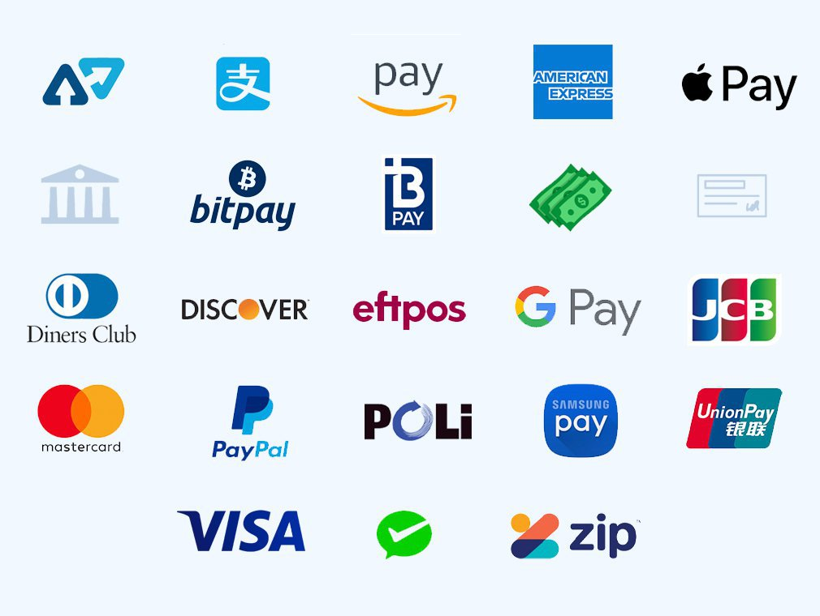

Business Processes
Commercial transactions: e-commerce, payments, credit card spending
Private agencies: supply chain data, intra-day tick data from the exchange

Slide 11
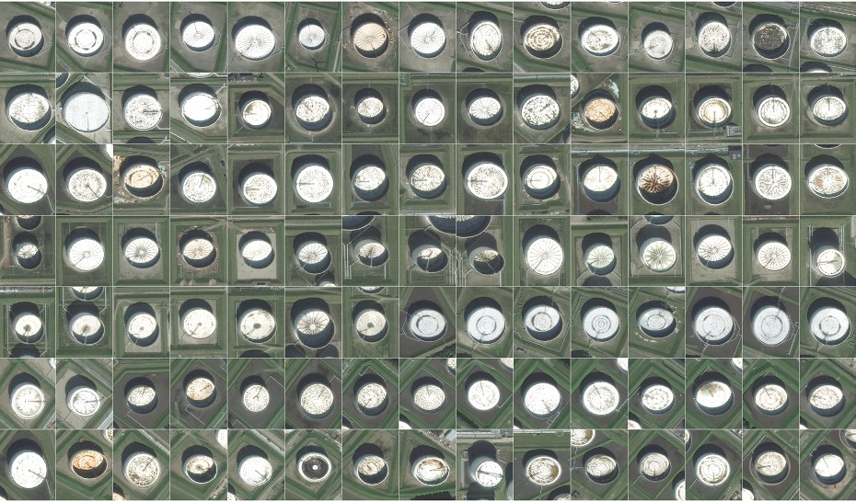
Satellite image: Oil Reserve
Oil reserves are often stored in floating tanks around the world, whose lid rises and falls with increasing or decreasing storage. With the rising and falling height, the crescent-shaped shadows cast by the sun also change shape. By tracking these shape changes (AI techniques), Orbital Insights predicts oil inventory levels.

Slide 12
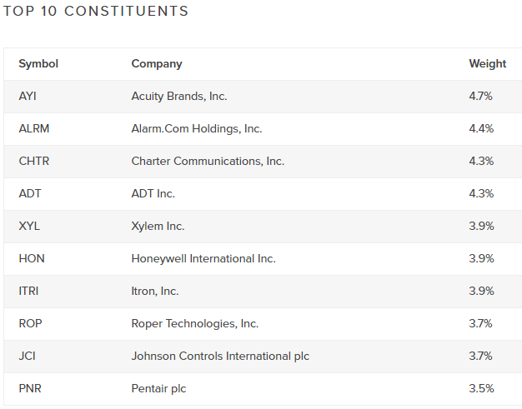
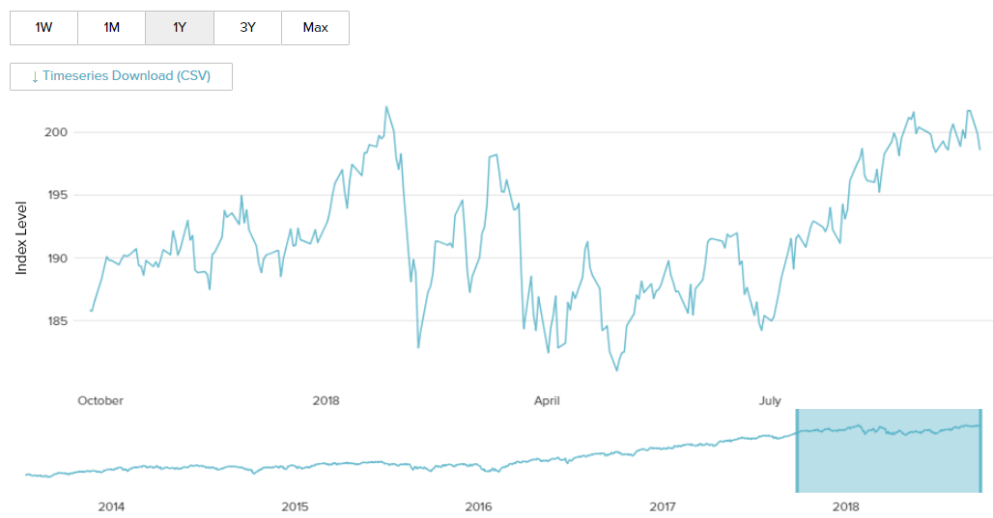
Robo-Advisor: AI ETF
Kensho Indices: constructed using an entirely systematic, big/alternative data (example from SpaceKnow) and rules-based methodology
Kensho Intelligent Infrastructure℠ Index

Slide 13
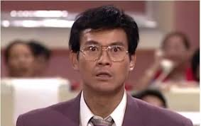
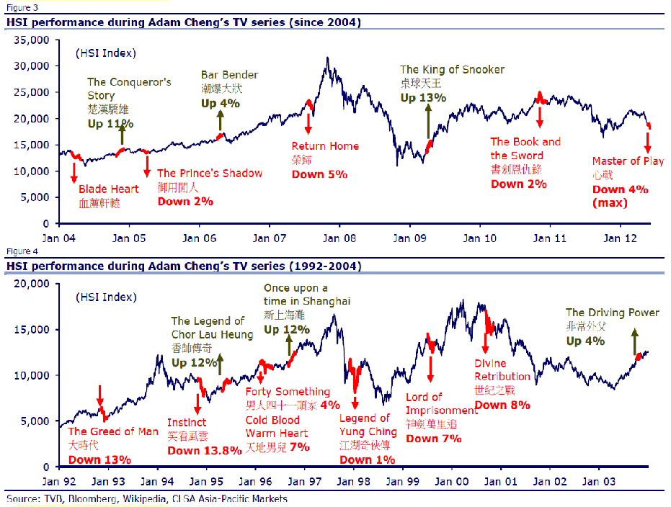
Sentiment Analysis
丁蟹效應 / Ting Hai Effect
Notes:
e.g. People over worry about the typhoon coming and insurance stocks are too over-sold

Slide 14
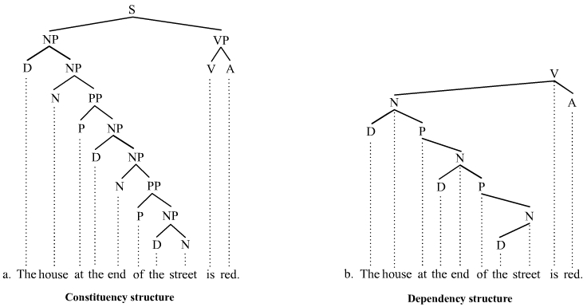
Natural Language Processing (NLP)
Treebanks
Example: Stanford Sentiment Treebanks
Notes:
Corpus, Treebank: manually prepare a lot data

Slide 15
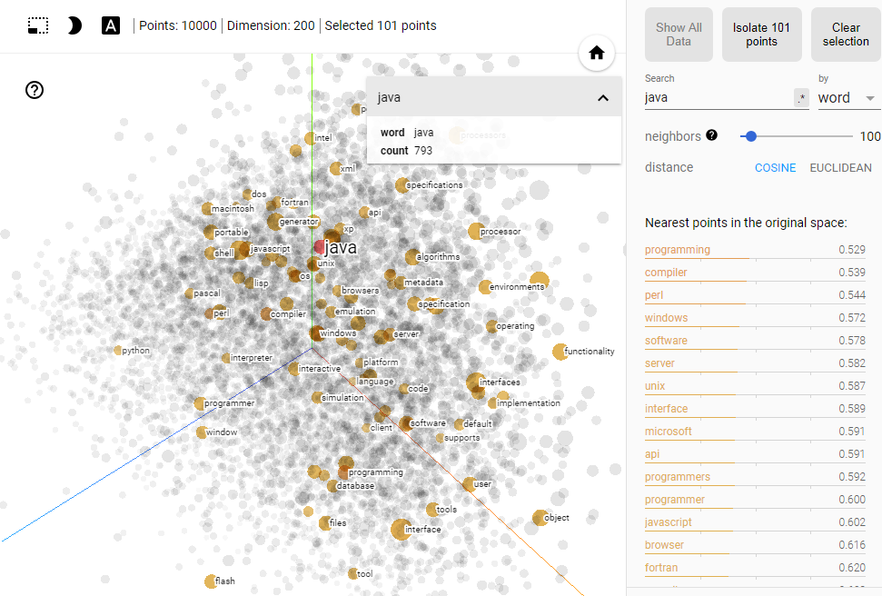
Word2Vec
Code example of Word2Vec
Interactive Demo

Slide 16
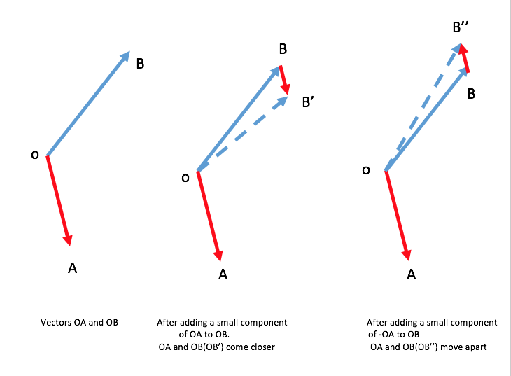
Word2Vec – Definition
Example: Mary is a very stubborn child. Her pervicacious nature always gets her in trouble: pervicacious is surrounded by stubborn, nature, and trouble.
Context: a fixed number of words in front of and behind the word of interest. Learns the meaning of a given word by looking at its context and representing it numerically. (“a word is characterized by the company it keeps - John Rupert Firth”)

Slide 17
Word2Vec – Definition
Skip-Gram Training data (Window = 2):
I would like to go someplace nearby for lunch
Input | Output
go | like
go | to
go | someplace
go | nearby
Input | Output
someplace | to
someplace | go
someplace | nearby
someplace | for

Slide 18
Word2Vec – Dissimilarity
JPMorgan Equity Research Report 2007 - 17
doesnt_match('revenue tax sales income'.split())
Out: 'tax'
doesnt_match('apple samsung microsoft'.split())
Out: 'microsoft'
doesnt_match('apple ibm microsoft'.split())
Out: 'apple'
doesnt_match('car pe pb growth'.split())
Out: 'car'

Slide 19
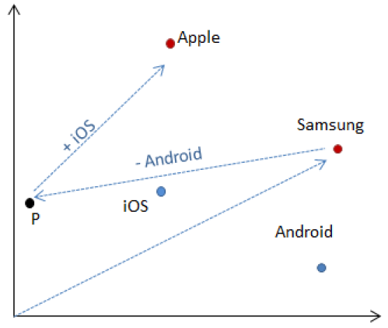
Word2Vec – Addition and Subtraction
JPMorgan Equity Research Report 2007 - 17
most_similar(
positive=['samsung', 'ios'],
negative=['android'])
[('apple', 0.35112401843070984)]

Slide 20
Word2Vec – Corpus comparison
JPMA | Google News
Driver
contributor | drivers
drivers | Driver
catalyst | motorist
determinant | driving
culprit | car
beneficiary | motorcyclist
determinants | wheel
differentiator | Drivers
detractor | truck
contributors | vehicle
JPMA | Google News
overweight
neutral | Overweight
ow | underweight
underweight | obese
uw | morbidly_obese
constructive | obesity
cautious | Underweight
selective | severely_obese
pt | metabolic_syndrome
intact | waist_circumference
bullish | BMI

Slide 21
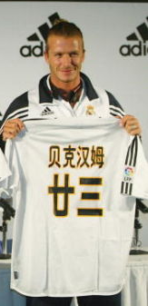
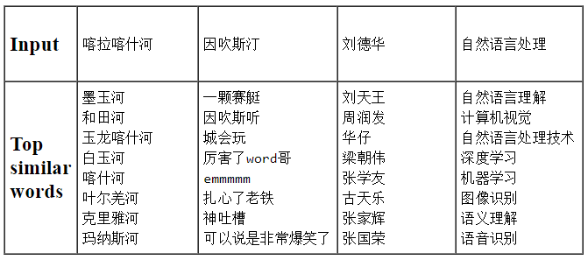

Word2Vec – Chinese Language
Tencent AI Lab Embedding Corpus for Chinese Words and Phrases
Training Data: News, Webpages, Novels, Wikipedia and Baidu Baike
Wechat ?

Slide 22
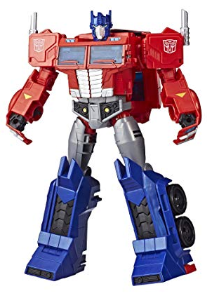
Latest NLP Developments
Talk to Transformer
Chinese Novel Generation
GPT-2 Language Model
Trained to predict the next word in 40GB of Internet text. It is a large transformer-based language model with 1.5 billion parameters, trained on a dataset of 8 million web pages.
GPT-3
175 billion parameters
GPT-3-powered business idea generator

Slide 23
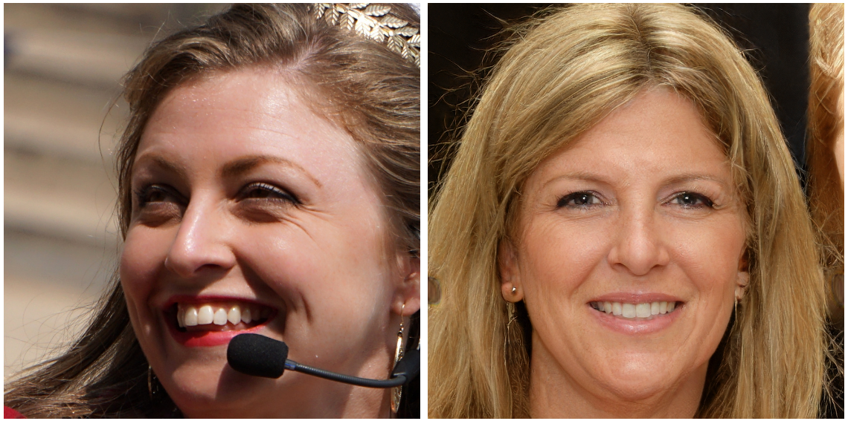
GANs (Generative Adversarial Networks)
StyleGAN: Which face is real ??
AI Creates Fashion Model with Custom Outfits and Poses
Other GANs Applications

Slide 24

GANs (Generative Adversarial Networks)
Deep Fake
Infernal Affairs 2020 GANs version
Actors: Andy Lau & Tony Leung ??

Slide 25
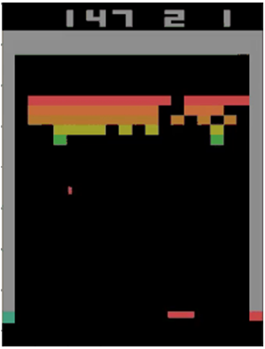
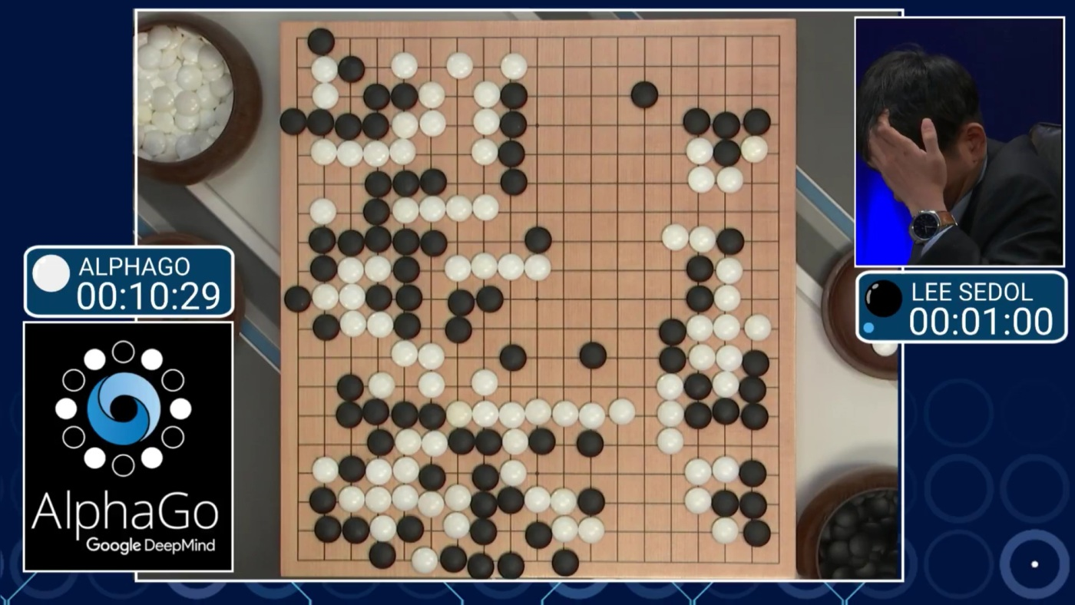
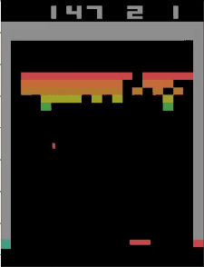
Alpha Go
Tunneling !

Slide 26
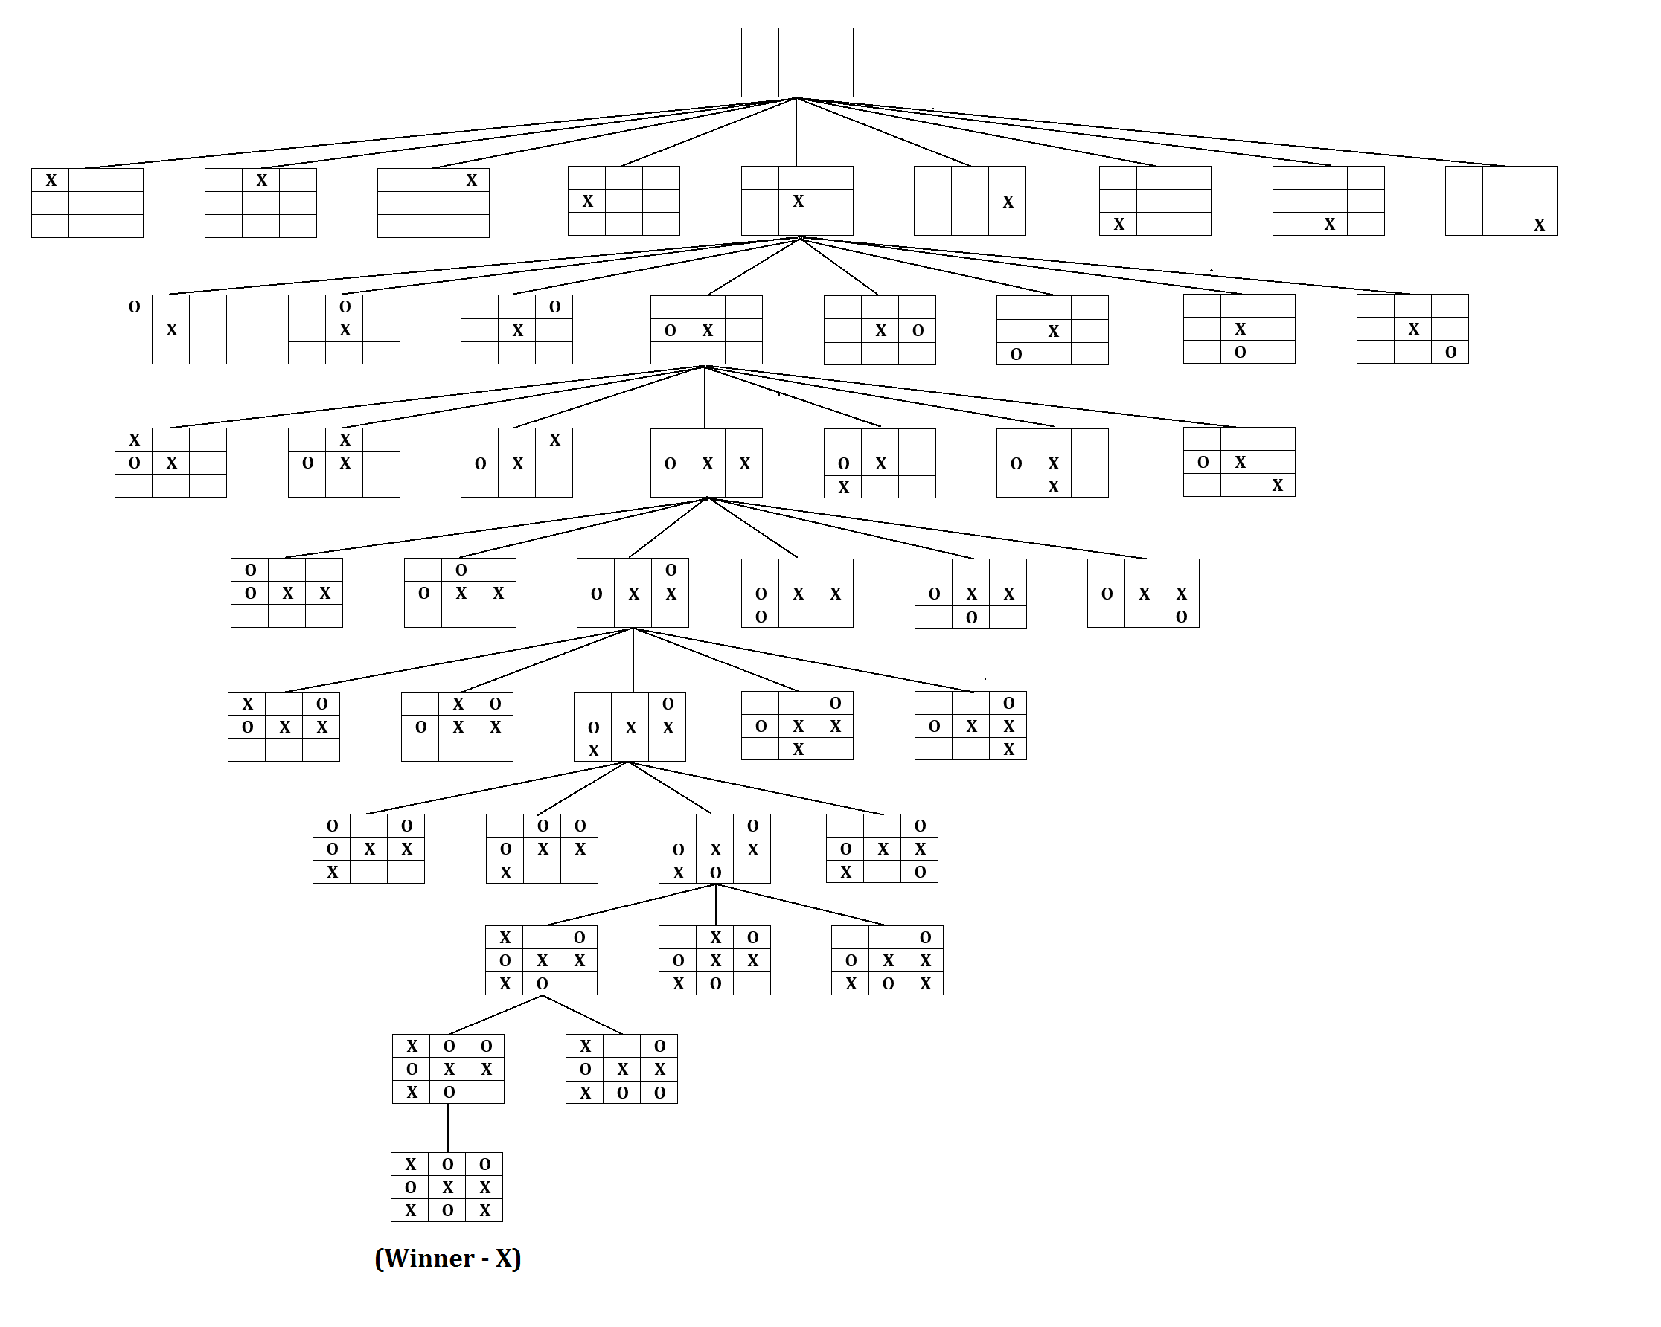
Traditional AI Approach
Game Search Tree

Slide 27
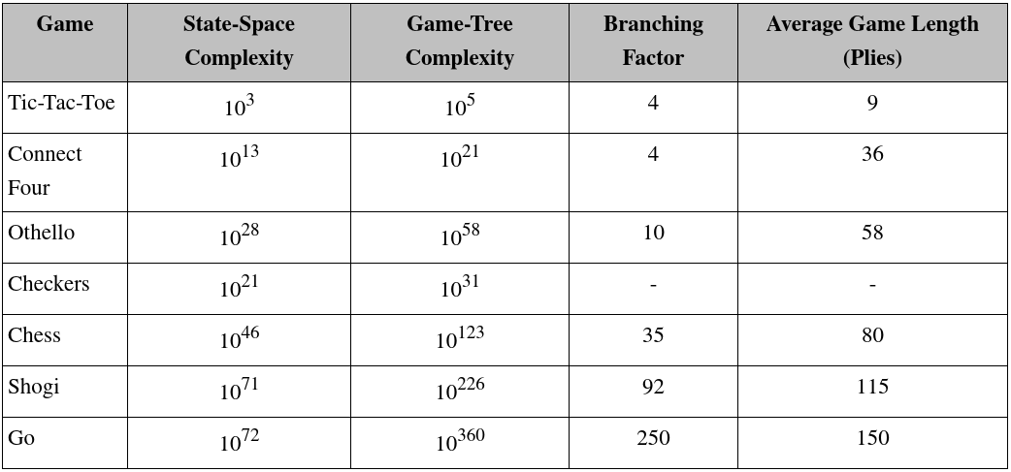
Traditional AI Approach

Slide 28

Reinforcement Learning
Software agents to take actions in an environment so as to maximize some notion of cumulative reward to achieve the objective.
The feedback (rewards or punishments) can be delayed.

Slide 29
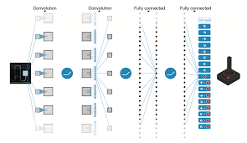
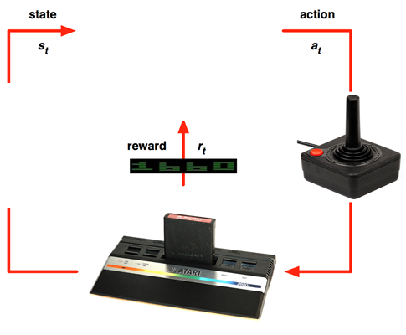

Deep Reinforcement Learning
Just play the game and record each frame (state) and action as the input and the corresponding reward as the output
Each frame is just an image and hence train CNN (Convolutional Neural Network) to approximate the input images (states and actions) to the output rewards relationships
Supervised Learning learns Relationship (Classification / Regression); RL learns Policy (Strategy)
Key Idea: Deep Learning + Reinforcement Learning = Deep Reinforcement Learning

Slide 30
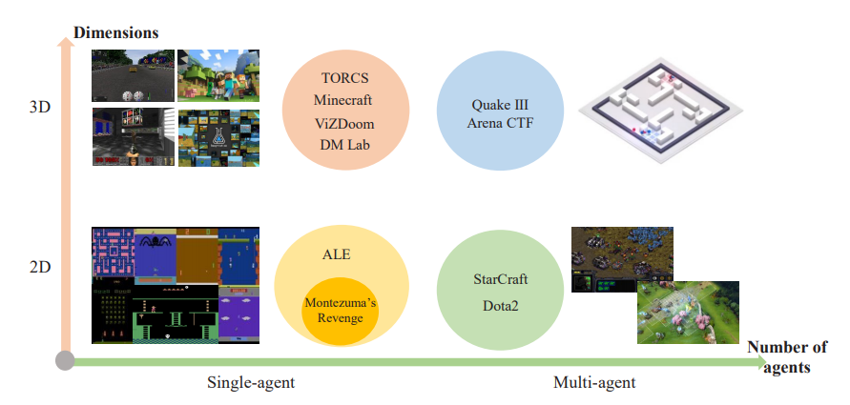
Deep Reinforcement Learning
This method is very generic and can apply to many different games: Code Demo
Source: A Survey of Deep Reinforcement Learning in Video Games

Slide 31
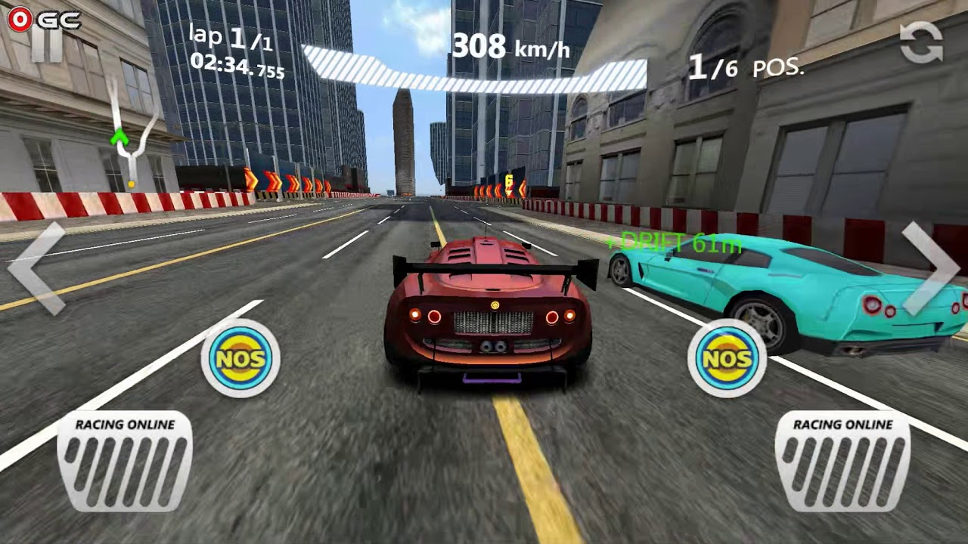
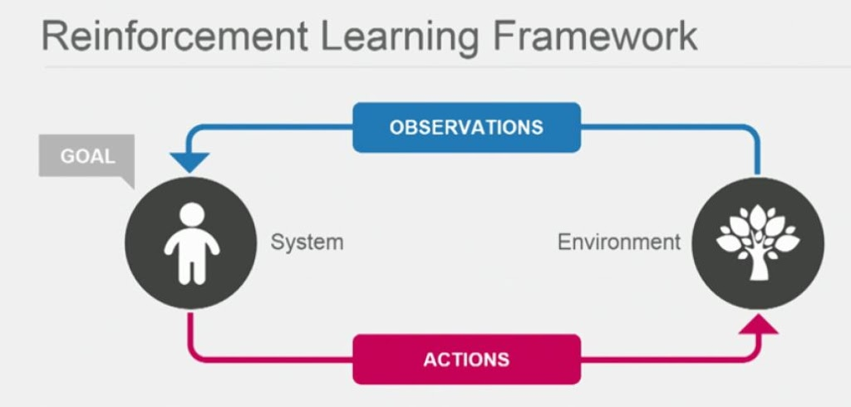
Deep Reinforcement Learning on Self-driving
Apply deep reinforcement learning similar to a car racing game

Slide 32
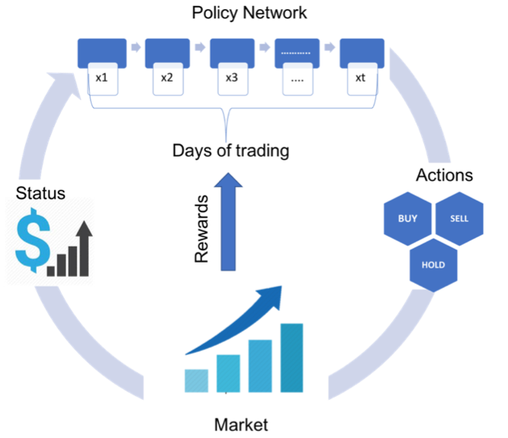
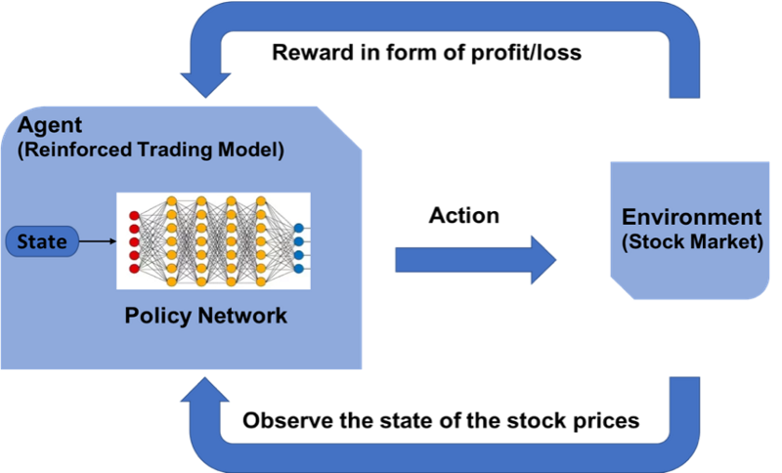
Reinforcement Learning on Trading
JP Morgan LOXM

Slide 33
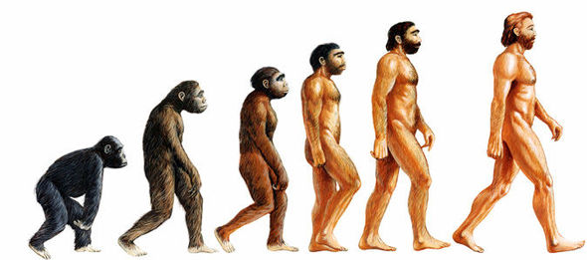
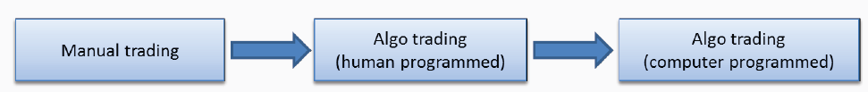
Reinforcement Learning on Trading
AI Traders -> Repeatedly Doing Backtest -> Find the Optimal Strategies

Slide 34
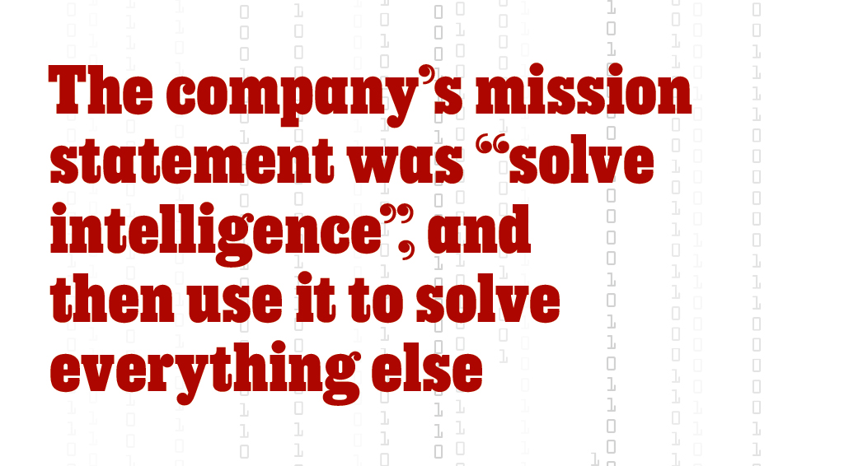
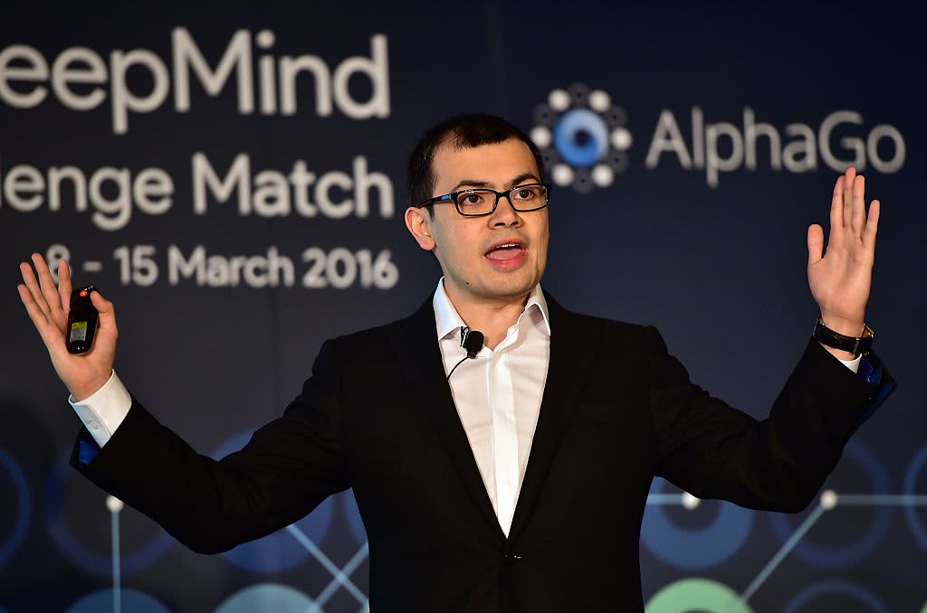
My Thoughts on AI

Slide 35
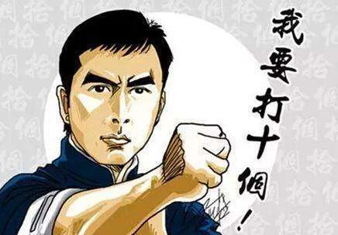
My Thoughts on AI
Can AI replace human ?
People are (much) smarter but machines work (much much) harder. Is it a race between rabbit & tortoise -> but tortoise cannot fly (limitation of the model)
3 idiots are better than one smart guy (三個臭皮匠，勝過一個諸葛亮) vs “One vs Ten” (一個打十個)
AGI (Artificial General Intelligence): machine is not real human-like intelligence “yet” but are you going to achieve true Intelligence?

Slide 36
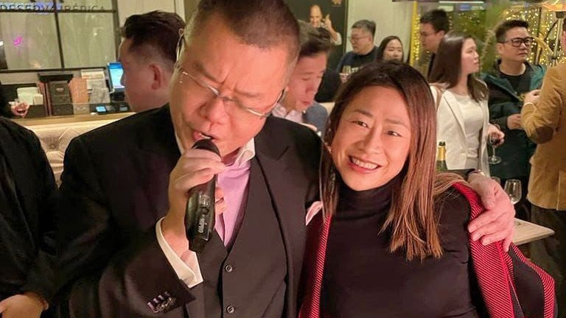
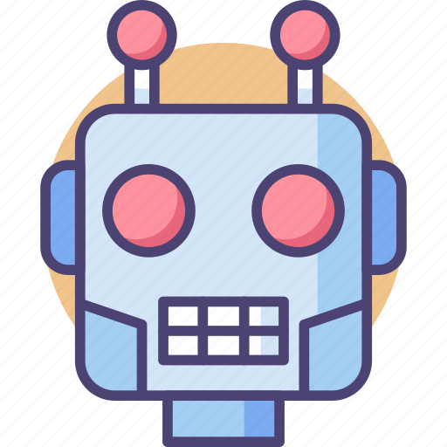
My Thoughts on AI
Can AI replace human ?
Biologist Emerson M. Pugh once said, “If the human brain were so simple that we could understand it, we would be so simple that we couldn’t”
Human being like to have “close touch” with human being

